Slide 1
Project: Depth-First Traversal—The Maze
CS455
Jia Zhan

Slide 2
Table of Content
Introduction
Manual process
Implementation
Conclusion
References

Slide 3
Introduction

Slide 4
Introduction:
Depth First Search (DFS) algorithm traverses a graph in a depthward motion and uses a stack to remember to get the next vertex to start a search, when a dead end occurs in any iteration.
Rule 1
Visit the adjacent unvisited vertex.
If there are several vertices, randomly pick one.
Mark it as visited.
Display it.
Push it in a stack.
Rule 2
If no adjacent vertex is found, pop up a vertex from the stack.
It will pop up all the vertices from the stack, which do not have adjacent vertices.
Rule 3
Repeat Rule 1 and Rule 2 until the stack is empty.

Slide 5
Manual process

Slide 6
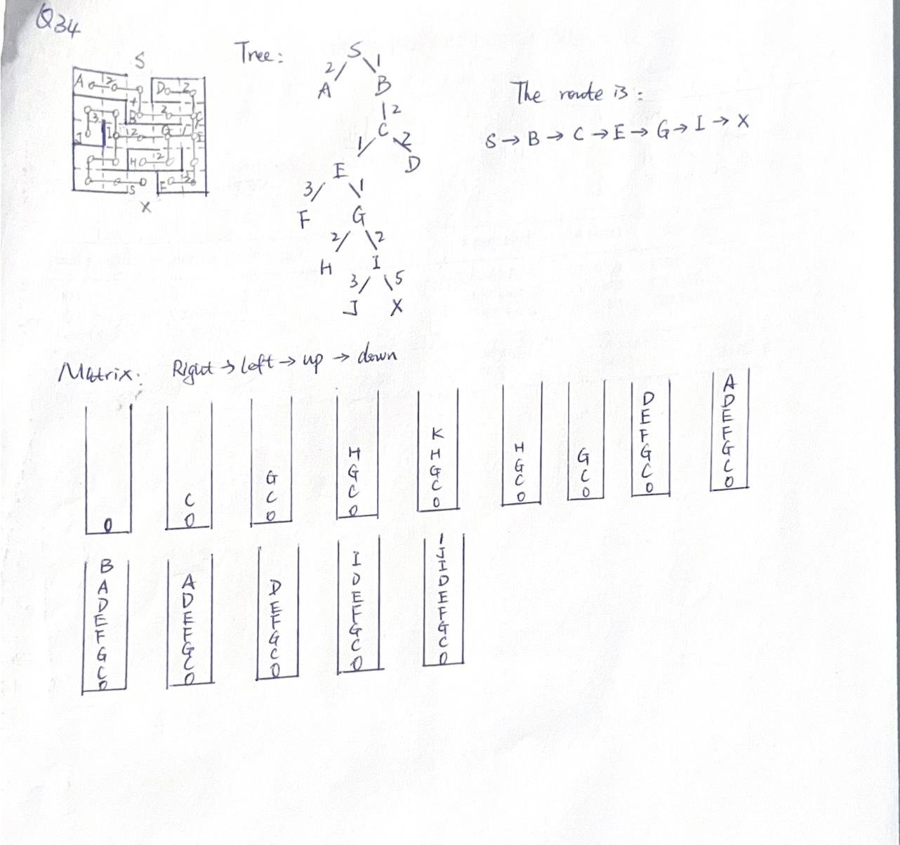

Slide 7
Implementation

Slide 8
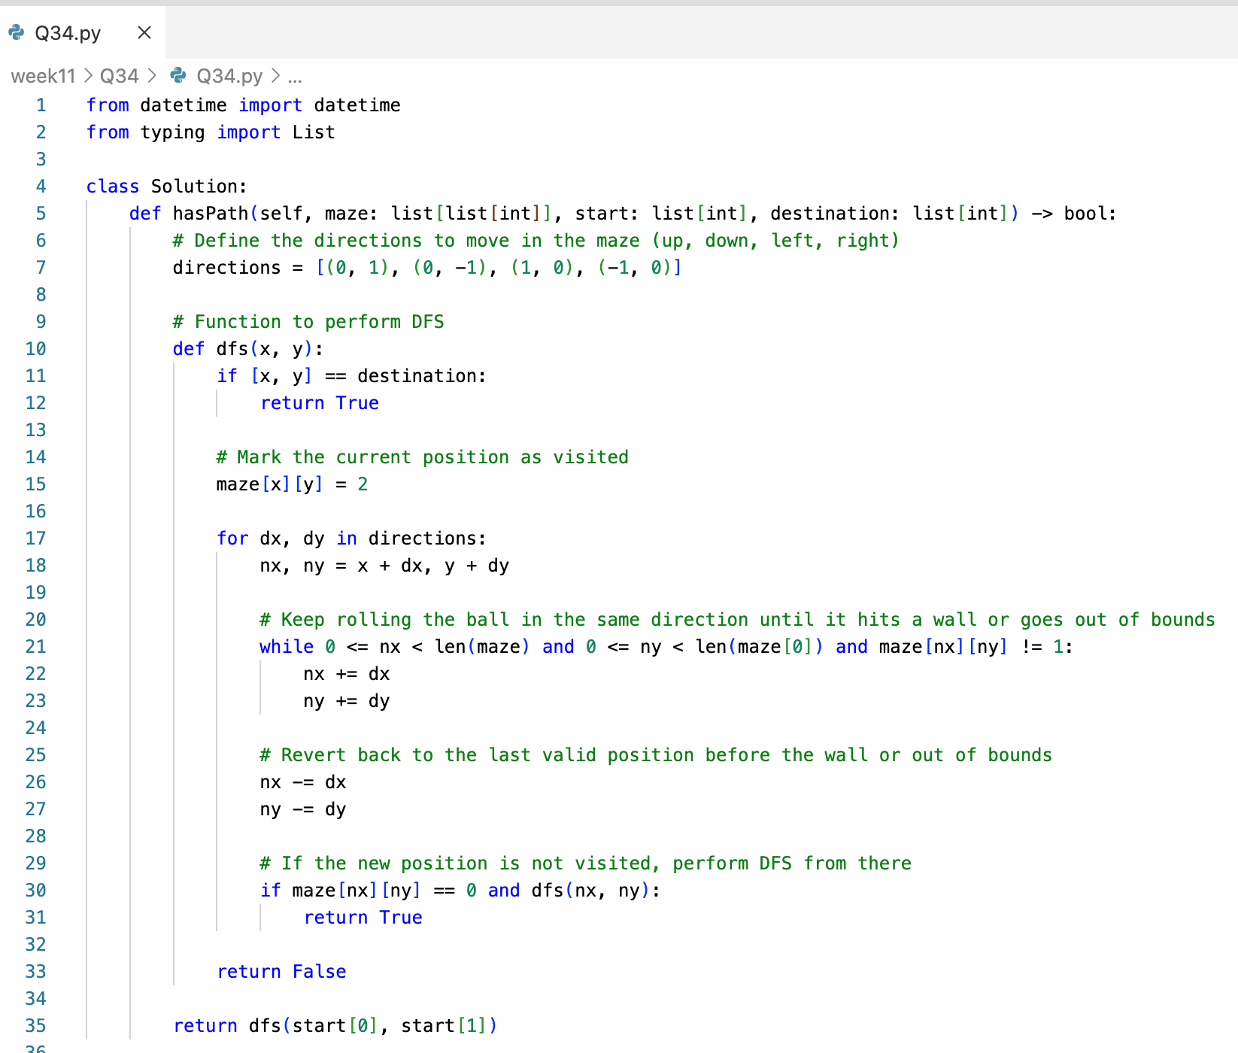

Slide 9
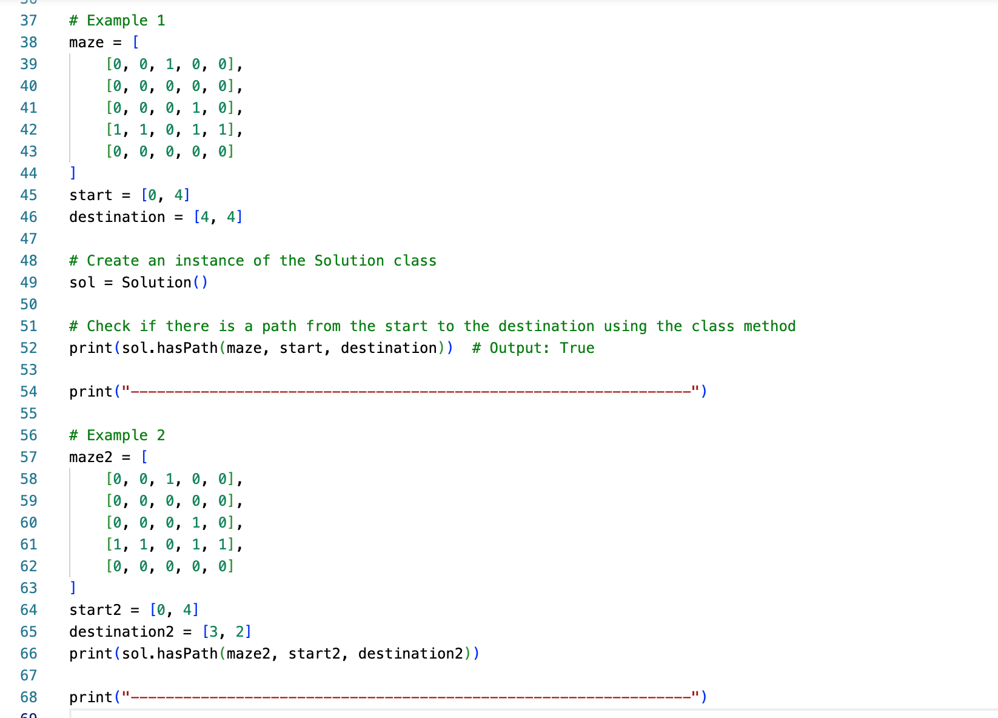

Slide 10
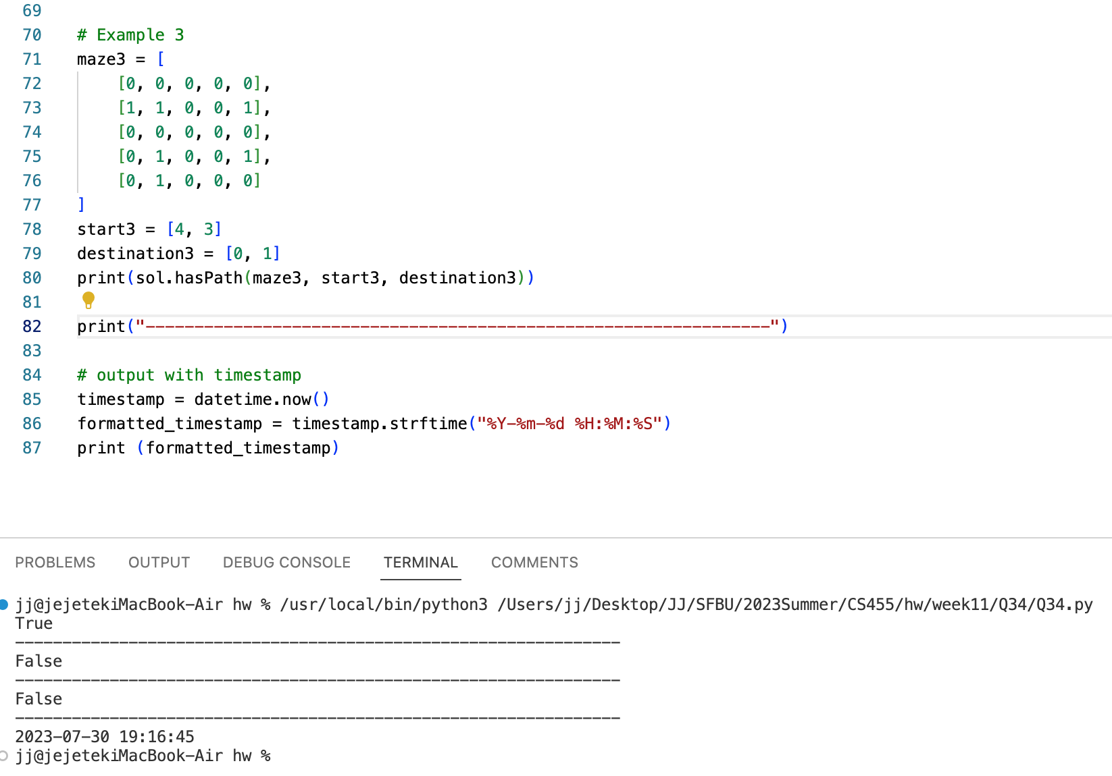

Slide 11
Conclusion

Slide 12
Conclusion:
Exploring Depth: Depth-First Traversal is an algorithmic approach used to explore data structures, such as graphs and trees, by traversing as far as possible along a branch before backtracking. This depth-first exploration can provide insights into the structure and relationships within the data.
Implementation Flexibility: Depth-First Traversal can be implemented using both recursive and iterative methods. Recursive implementations are elegant and mimic the natural recursive structure of trees, while iterative implementations often involve using a stack data structure to mimic the recursion's call stack.
Applications and Use Cases: Depth-First Traversal finds applications in a variety of fields, including graph theory, network analysis, pathfinding, and parsing. It is particularly useful when searching for paths, determining connectivity, and performing tasks that involve exploring hierarchical or interconnected data.
Considerations and Limitations: While Depth-First Traversal has its advantages, such as efficiently visiting nodes in some cases, it also has limitations. It may not guarantee the shortest path, and its behavior can vary based on the order of node traversal. In cases of deep recursion, there's a risk of stack overflow issues. Therefore, understanding when to use Depth-First Traversal and being aware of its limitations is essential for effective algorithmic design.

Slide 13
References

Slide 14
References:
Depth First Traversal
Maze

